Slide 1


Ethics in Data Science: A Responsible Approach
by Oyiza Ibijola

Slide 2
Introduction to Ethics in Data Science
Definition
Importance
Ethics in data science refers to the responsible use of data, ensuring fairness, transparency, privacy, and accountability in how data is collected, analyzed, and applied.
It emphasizes minimizing harm, avoiding biases, and upholding trust in decision-making processes that impact individuals and society.

Slide 3

The Importance of Data Privacy
1
Protects Individuals' Rights
2
Builds Trust
Encourages confidence in organizations by demonstrating a commitment to handling data responsibly.
Ensures personal information is safeguarded, preserving autonomy and preventing misuse or unauthorized access.
3
Complaiance with Laws
Helps businesses adhere to regulations, in order to avoid legal penalties and reputational damage.

Slide 4

Ensuring Fairness in Data-Driven Decision Making
Identify Biases
Mitigation Strategies
Identify and regularly audit data and algorithms for biases (e.g., demographic, cultural and socioeconomic biases).
Implement strategies like re-sampling, re-weighting, fairness-aware machine learning, data augmentation and algorithmic fairness techniques to mitigate biases.
Ensure Representativeness
Use diverse and comprehensive datasets that accurately reflect the population to avoid skewed outcomes or unfair exclusions.

Slide 5



Transparency and Accountability in Data Usage
Comprehensible
Auditing
Make data-driven decisions and models understandable and explainable to stakeholders.
Regularly audit data practices to ensure compliance with ethical principles and regulations.

Slide 6
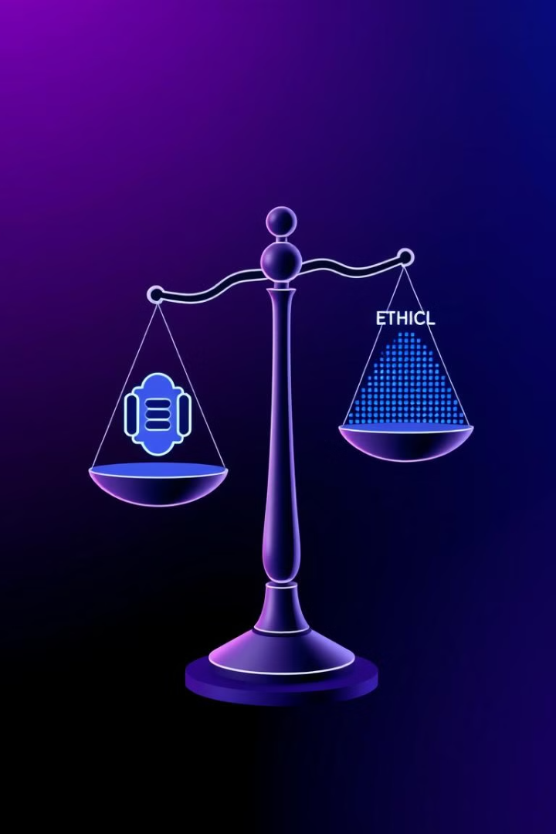
Balancing Innovation and Ethical Data Practices
1
Innovation
Keep up with trends, embracing innovative technologies and exploring new data-driven solutions.
2
Ethics
But, do not forget to integrate ethical principles and guidelines into data science processes and decisions.

Slide 7




Best Practices for Responsible Data Science
Privacy
1
Protect data privacy and security.
Fairness
2
Mitigate biases and ensure fair treatment.
Transparency
3
Ensure accountability and comprehensiveness.
Responsibility
4
Use data for positive impact and societal benefit.

Slide 8



The Future of Ethics in Data Science
Enhanced Regulation and Standards
Focus on Bias Mitigation
Integration of Ethical AI Principles
Advanced techniques and tools will emerge to identify and reduce biases in data and algorithms, fostering fairness and inclusivity in decision-making systems.
The establishment of stricter guidelines and frameworks will ensure ethical practices in data collection, usage, and AI development, emphasizing transparency and accountability.
Ethics will become a core component of AI and data science education, with cross-disciplinary teams (including ethicists) collaborating to design systems that prioritize human values and societal well-being.

Slide 9
Conclusion
1
Always integrate ethical considerations into all data science activities.
2
Be accountable for data decisions and their impact.
Reference
1
Kirk Stewart (2024), "The ethical dilemmas of AI." https://annenberg.usc.edu/research/center-public-relations/usc-annenberg-relevance-report/ethical-dilemmas-ai#:~:text=Here%20are%20some%20of%20the,lending%2C%20and%20law%20enforcement%20applications
2
https://gdpr-info.eu/ General Data Protection Regulation (GDPR).

